Slide 1
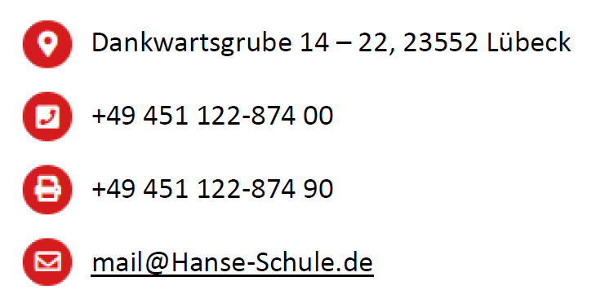
HANSE-SCHULE für Wirtschaft und Verwaltung und das duale System der Berufsausbildung
Hansa School of Business, Economics and Administration
Lübeck/Germany
and the dual system of vocational training
https://hanse-schule.de/

Slide 2
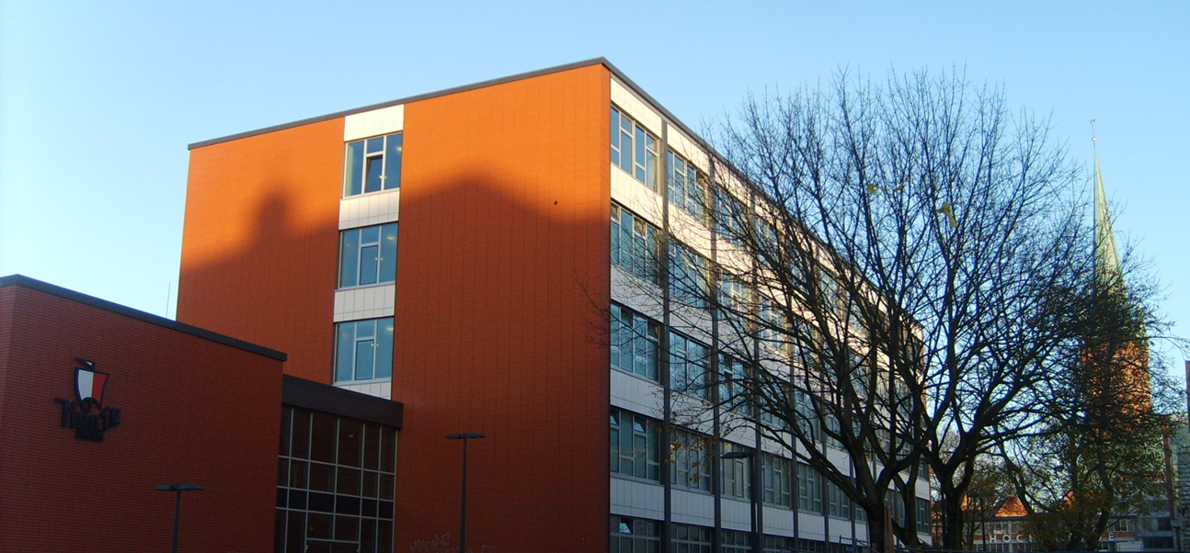
Focussing on business and economics….

Slide 3
Hanse-Schule– Short Facts I
Founded in 1905
Public institution
Around 1,700 full-time and part-time students
Around 75 lecturers
Around 100 classes
2 janitors
4 secretaries
2 school´s social workers

Slide 4
Hanse-Schule– Short Facts II
Computer labs
Laptop computers in mobile racks
Presentation rooms
2 language labs
Interactive boards in all classrooms
Wifi
Library
Assembly hall including stage and sound-/light system
Interactive Wall for announcements/presentations
Exhibitions
…

Slide 5
Hanse-Schule– Short Facts III
5 Full-time training programmes
14 Part time training programmes (within the Dual System of training)
3 additional training programmes within the Dual System of training
In cooperation with a university of applied science Bachelor of Arts

Slide 6
Hanse-Schule– Short Facts IV
Since 2015: Title European School
granted by the Ministry of Education of Schleswig-Holstein
Since 2017: Title Culture School
granted by the Ministry of Education of Schleswig-Holstein

Slide 7
Full-time training programmes
Type of training programmes | Duration | Requirement | Goal
Professional School | 2 years | First school certification, completed after 9 school years | Intermediate certification
Technical School | 1 year | Intermediate Certification | Technical college entrance qualification entitling enrolment to a vocational high school or to a University of Applied Sciences
Vocational High School | 1 year | Technical college entrance qualification | University entrance qualification

Slide 8
Part-time programmes within dual system
14 part-time training programmes:
Retail
Industrial business
Event management
IT-Services
Banking
Insurance
General Office
Human Resources
Legal and Notary
Taxes
Postal Services
Public administration

Slide 9
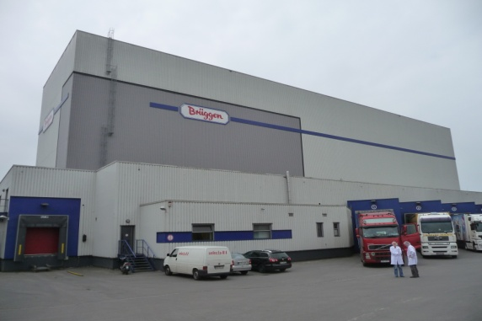
How to become a trainee under the dual system?
3 partners involved:
Lübeck Chamber of Industry and Commerce
or a different independant institution such as Chamber of Tax consultants

Slide 10
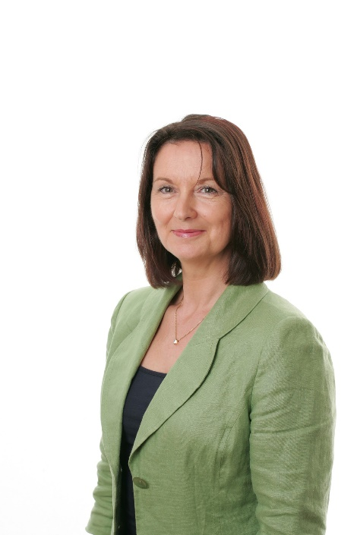
How to become a trainee under the dual system?
Training contract

Slide 11
Part-time programmes under dual system
Duration:
usually 3 years
Goals:
professional diploma
if applicable intermediate school qualification, entitling enrolment for further education

Slide 12
Thank you for listening

